Slide 1
SDLC The Design Stage
ICS 3U0

Slide 2
Today’s Agenda
Go into more detail about the design stage of the Software Development Life Cycle
Learn about tools to help with good software design such as writing pseudocode, writing algorithms,
and creating flow charts

Slide 3
The Design Stage
Recall that the design stage takes as its initial input the requirements identified in the previous stage of software development.
The output of the design stage is the design document which houses the details of all the code that will be written in the next stage.
A computer only performs exactly what it is told to do, even if it is not what a programmer has in mind. Because of this, it is extremely important that appropriate effort is put forth in the design stage so that robust, quality and efficient code is developed.

Slide 4
Pseudocode
Computational algorithms are often described using pseudocode.
In fact, if pseudocode is well-written, it is usually fairly easy to translate it into a computer program, assuming that the programmer is familiar with a language’s syntax and commands.

Slide 5
Pseudocode Guidelines
While there are no official rules concerning pseudocode, here are some recommended guidelines:
Write one statement per line. This ensures each task is clearly identifiable at a glance.
Use a verb as a keyword, and capitalize it for emphasis. This makes it easy to spot the actions involved in the task.
Use indentation to group related tasks, such as decisions or repetitive processes. This makes pseudocode more readable.
Ensure that pseudocode is language-independent. An individual should be able to follow your pseudocode without requiring knowledge of a specific programming language.

Slide 6
Example of Pseudocode
An example of pseudocode for making buttered toast.
PUT bread in toaster
PRESS lever down so toaster is on
WHILE bread is not toasted
WAIT for bread to turn golden brown
POP toast up
PUT toast on plate
SPREAD butter onto toast

Slide 7
Pseudocode and Actual Code
Pseudocode
GENERATE random number between 1 and 10
READ guess
SET count = 1
WHILE guess not equal to random number
READ guess
INCREMENT count by 1
PRINT count
Actual Code
import random
num = random.randint(1,10)
guess = int(input("Guess: "))
count = 1
while guess != num:
guess = int (input ("Nope. Guess again: "))
count += 1
print("Correct! You guessed the number in", count, "guesses!")

Slide 8
Flowcharts
Some people prefer to design code graphically, so that they can visualize program flow better.
Flowcharts are graphical representations of algorithms. They use standard symbols to represent different actions, and connect each step in some logical sequence.

Slide 9
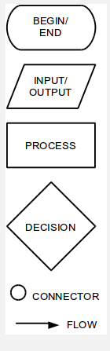
Flowchart Symbols
The graphic to the right shows some of the more common symbols used. There are many more, but this lesson only covers a small subset. We will introduce other symbols as necessary.
Each flowchart begins and ends with a terminator. This indicates where the algorithm starts, and where it finishes – it’s an oval.
Between the terminators, each step is connected by an arrow indicating which step follows another called a connector.

Slide 10
Flowchart Symbols
Other common symbols used are:
Parallelogram: indicates input or output, such as reading data from the user or displaying information to the screen.
Rectangle: indicates a process, such as assigning a value to a variable or performing some mathematical operation.
Diamond: indicates a decision, where the answer is typically “yes/no” or “true/false”. Each arrow leading out of a diamond should be labeled with the result of the decision.

Slide 11
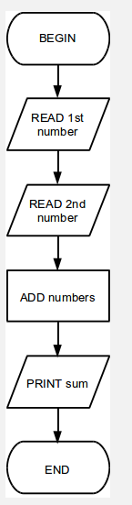
Example of a Flowchart
This flowchart shows how to add two values together and print their sum.
Remember ...
Terminator are ovals
Input/Output are parallelograms
Processes are rectangles
Diamonds are decisions (but there are none here)

Slide 12
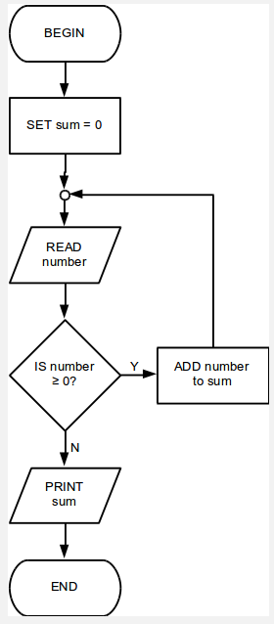
Another Example of a Flowchart
This flowchart adds inputted values until -1 is entered.
Remember ...
Terminator are ovals
Input/Output are parallelograms
Processes are rectangles
Diamonds are decisions

Slide 13
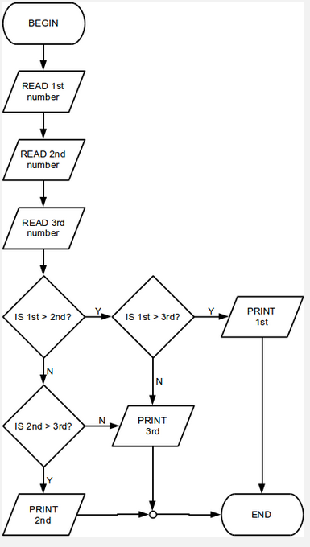
You Try!
Consider the problem of determining the largest of three numbers. Create a flowchart that illustrates the algorithm.

Slide 14
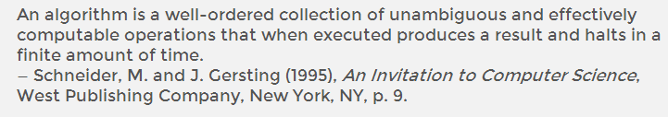
Algorithms
To successfully solve a problem, it is necessary to establish a set of rules that will allow us to find the solution. In computer science and in mathematics, the term for this is an algorithm.
A more precise definition of an algorithm would be something like this:

Slide 15
Example of an Algorithm
We use algorithms every day. Take, for example, the following algorithm for making scrambled eggs. Your method of making scrambled eggs may be different from the one below.
Turn on the heat on the stove.
Place a pan on the burner.
Put a spoonful of butter in the pan.
Crack an egg into a bowl.
Whisk the egg until it is scrambled.
Pour the scrambled egg into the heated pan.
Stir the egg until it is cooked.
Turn off the heat.
Remove the pan from the burner.
Transfer the egg to a plate.
Enjoy breakfast.
Each step is clearly defined, and well-ordered.
All recipes are analogous to algorithms, in this sense.

Slide 16
Algorithms – Some Videos
Video: How to Cook Beef Stroganoff (and Fight Off a Ninja)
Video: Honda: The Cog
Video: The Page Turner

